Slide 1



Fake News Detection with Machine Learning
By Nikolaos Nteits & Alexandros Dimakos
27/1/2025

Slide 2
Reasons why this paradigm was chosen…

Slide 3
Protecting society from misinformation is crucial in today's digital age.
Importance of Accurate Information for Society's Stability : Ensuring that the information consumed by the public is accurate is vital for societal stability, as misinformation can lead to misguided beliefs and actions.
Role of Education in Combatting Misinformation: Educating individuals about the nuances of information and media literacy is essential to protect against the influence of misleading narratives.
Impact of Digital Platforms on Information Spread: Digital platforms significantly amplify the spread of misinformation, necessitating proactive measures from both companies and users to mitigate its effects.
Strategies for Raising Public Awareness on Misinformation: Implementing public awareness campaigns can effectively inform individuals about the dangers of fake news, enabling them to critically evaluate the information they encounter.

Slide 4
Detection mechanisms are vital to safeguard less educated individuals.
Creating detection systems that are accessible to less educated individuals can help protect them from being misled by false information. Advanced algorithms and AI can enhance detection mechanisms, making them more effective in identifying and flagging fake news. Community programs aimed at improving information literacy can help empower less educated individuals to critically evaluate news sources. Effective detection mechanisms can rebuild public trust in media by ensuring that individuals receive accurate and reliable information.

Slide 5
Fake news impacts public opinion and can alter democratic processes.
Influence of Fake News on Voter Behaviour: The dissemination of fake news can sway voter opinions, thereby impacting election outcomes and undermining democratic processes.
Long-term Consequences of Misinformation on Democracy: Persistent exposure to fake news can erode public trust in legitimate news sources, ultimately threatening democratic institutions.
The Role of Social Media in Fake News Propagation: Social media platforms are often breeding grounds for fake news, amplifying its reach and making it difficult for users to discern credible information.
Countermeasures Against Misinformation in Political Arenas: Developing robust strategies to identify and counter misinformation is critical to safeguarding democratic integrity and informed citizenry.

Slide 6
Diverse datasets enable comprehensive performance evaluations.
Role of Diverse Datasets in Evaluations: Diverse datasets are integral in evaluating the generalizability of machine learning algorithms across various contexts and scenarios.
Challenges in Dataset Diversity: Ensuring dataset diversity poses challenges, including bias mitigation and ensuring representative samples to reflect real-world complexities.
Creating Balanced Datasets for Fair Evaluation: Creating balanced datasets is crucial for fair evaluation, ensuring algorithms are tested on equally represented classes of data.
Impact of Dataset Quality on Evaluation: The quality of datasets directly impacts the evaluation outcomes, making it essential to utilize high-quality, well-structured datasets.

Slide 7
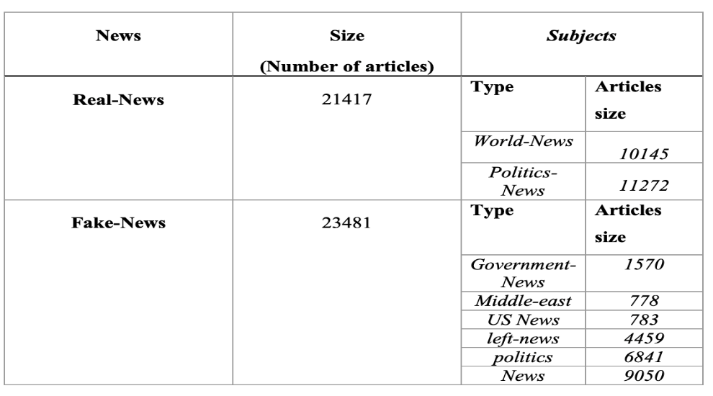
The Dataset
The domain chosen was Natural Language Processing and we decided to address a fake vs true news classification problem and proceeded as the exercise indicated. Where are the data from?

Slide 8
Import Packages and Data Preparation Steps
Core Libraries for Data Manipulation and Analysis: Essential libraries such as pandas simplify data handling, enabling efficient data analysis and manipulation during the project.
Text Processing with NLTK for Enhanced Data Quality: Utilizing NLTK for comprehensive text processing ensures refined data by removing stopwords and performing stemming.
Machine Learning Frameworks for Model Development: Scikit-learn provides a robust framework for implementing various machine learning algorithms, enhancing model accuracy and evaluation.
Word Embeddings with Word2Vec for Semantic Understanding:Word2Vec captures the semantic meaning of words, enriching text representation through 300-dimensional embeddings for improved model performance.

Slide 9
Leveraging NLTK for comprehensive text preprocessing steps
Critical Text Cleaning Steps for Data Refinement: Implementing a rigorous cleaning pipeline with NLTK ensures that the dataset is devoid of noise and irrelevant information.
Tokenization for Structured Text Analysis: Tokenization transforms raw text into manageable pieces, allowing for deeper analysis and understanding of textual content.
Stemming to Normalize Text Data: Applying stemming reduces words to their root forms, standardizing variations and enhancing model training consistency.
Stopword Removal to Enhance Model Focus: Eliminating common stopwords through NLTK sharpens the focus of models on significant words that convey meaning.

Slide 10
Text Preprocessing and Feature Extraction Techniques
Key text cleaning steps for improved data quality and model accuracy
Importance of Lowercasing in Text Processing for Consistency Across Datasets: Lowercasing ensures uniformity in text data, reducing discrepancies caused by case sensitivity.
Significance of Special Character Removal in Data Preparation for NLP: Removing special characters and HTML tags enhances text clarity, crucial for accurate analysis in NLP.
Effective Tokenization Techniques for Clear Word Separation in Text: Tokenization effectively divides text into distinct words, allowing for granular analysis and processing.

Slide 11
Exploring various vectorization methods for feature extraction
Four Vectorization Techniques:
Binary CountVectorizer to track word presence and because it is simpler and faster, that makes it ideal for detecting buzzwords like "Trump" or "GOP".
2. CountVectorizer to track counts of words in documents. While simpler than TF-IDF or Word2Vec, CountVectorizer's speed and interpretability made it a strong choice, especially for real-time application.
3. TF-IDF weights words by importance words by importance ,thus surfacing contextually significant phrases like "anonymous sources".
4. Word2Vec to model semantic relationships, such as nuanced fake-news tactics like "alien allies" ↔ "conspiracy", we used (300-dimension embeddings) as in the Big Data Mining Class.

Slide 12
Hyperparameter tuning for optimized logistic regression models
Four Vectorization Techniques have been used:

Slide 13
Model Training & Evaluation
The algorithms for training and testing are as follows:
Logistic Regression (with L1 regularization, Lasso model/with L2 regularization, Ridge model)
Naive Bayes
Support Vector Machines
Decision Trees
AdaBoost Classifier
Random Forest

Slide 14
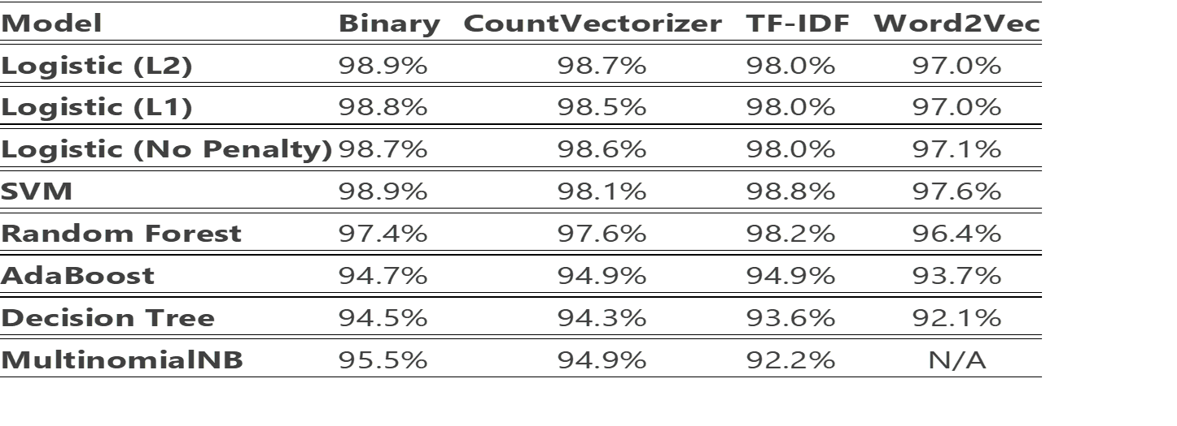
Model Accuracy Comparison "Accuracy Across All Models and Vectorizers"

Slide 15
Hyperparameter tuning for optimized logistic regression models
Hyperparameter tuning for Logistic Regression and default parameters for the other models:

Slide 16
Testing the model using AI generated custom examples
Fake News Detection Example:
['BREAKING: Donald Trump Announces Plan to Colonize Mars Former. President Donald Trump unveiled an ambitious plan today, declaring his intention to lead the charge in colonizing Mars. Speaking at a rally, he stated, “No one’s ever done Mars like we’re going to do it. It’ll be tremendous, believe me.” Trump claimed his new initiative, "Trump Galactic," would establish "the biggest, most luxurious Martian city ever." Critics dismissed the plan as unrealistic, but supporters hailed it as visionary. SpaceX founder Elon Musk declined to comment, fueling speculation about potential collaboration. Stay tuned for developments on this out-of-this-world endeavor. ']
# Output: 1 (Fake)
Sensational claims paired with political keywords like “Trump” triggered the model’s fake news indicators.

Slide 17
Testing the model using AI generated custom examples
Real News Detection:
['A former Colorado Bureau of Investigation DNA scientist appeared in court Thursday to face criminal charges over data tampering that authorities said raises questions about the validity of more than 500 cases. Problems with the scientist’s work were found in cases involving homicide, sexual assault, robbery and other crimes, according to a law enforcement affidavit. In at least two cases, both homicides, the defendants received lesser sentences under plea deals than they could have faced if they went to trial because prosecutors were afraid Yvonne “Missy” Woods’ involvement could lead to acquittals. Woods was described as a “star analyst” by a former colleague who was interviewed by investigators, but also one who worked too fast and was “not the most thorough,” according to an internal affairs report. Authorities haven’t found any evidence of wrongful convictions, but prosecutors across the state are continuing to review the impacted cases. “This gets to the heart of whether or not science can be trusted, whether or not law enforcement can be trusted and quite frankly whether the judicial system can be trusted,” Jefferson County judge Graham Peper said during the short hearing. Woods allegedly told investigators at one point that she had changed data to complete cases more quickly, according to an arrest affidavit. Woods faces 52 counts of forgery, 48 counts of attempting to influence a public servant and one count each of perjury and cybercrime, for alleged misconduct between 2008 and 2023.The fallout from the alleged misconduct is still unfolding. In the most recent case to be impacted, Michael Shannel Jefferson was sentenced last week to 32 years in prison in the home invasion killing of Roger Dean in 1985. Jefferson was identified as a suspect in the cold case in 2021 through DNA evidence.']
# Output: 0 (Real)
Factual language, specific locations (“Colorado”), and procedural terms (“data tampering”) align with real news patterns.

Slide 18
Analysis of Key Predictive Features for Fake News
Fake News Predictors (Positive Coefficients)
Words with positive coefficients increase the likelihood of an article being classified as fake news:
via (3.24): May indicate indirect sourcing (e.g., "via unnamed sources") common in unverified claims.
sen (1.89): Short for "senator" or "senate," suggesting politicized language or sensationalized political narratives.
gop (1.81): References to the Republican Party, possibly signaling partisan rhetoric.
obama (1.80): Mentions of polarizing figures could align with emotionally charged or outdated claims.
rep (1.79): Abbreviation for "Republican" or "representative," again pointing to politicized content.
imag (1.76): Could relate to "image" (misleading visuals) or "imagine" (hypothetical scenarios).

Slide 19
Analysis of Key Predictive Features for Fake News
Real News Indicators (Negative Coefficients)
Words with negative coefficients correlate with real news:
said (-2.39): Reflects proper attribution of quotes, a hallmark of credible journalism.
thursday (-1.76) and wednesday (-1.73): Specific days of the week suggest timely, event-based reporting.
dont (-1.76): May appear in quotes or factual statements (e.g., "experts don’t agree"), common in balanced reporting.

Slide 20
References
https://www.kaggle.com/datasets/emineyetm/fake-news-detection-datasets
Katsaros D., Stavropoulos G., and Papakostas D. ,"Which Machine Learning Paradigm for Fake News Detection?" WI '19: IEEE/WIC/ACM International Conference on Web Intelligence, vol. 383-387, 2019, https://doi.org/10.1145/3350546.3352552
https://edition.cnn.com/2025/01/24/us/colorado-dna-analyst-forgery-charges

Slide 21
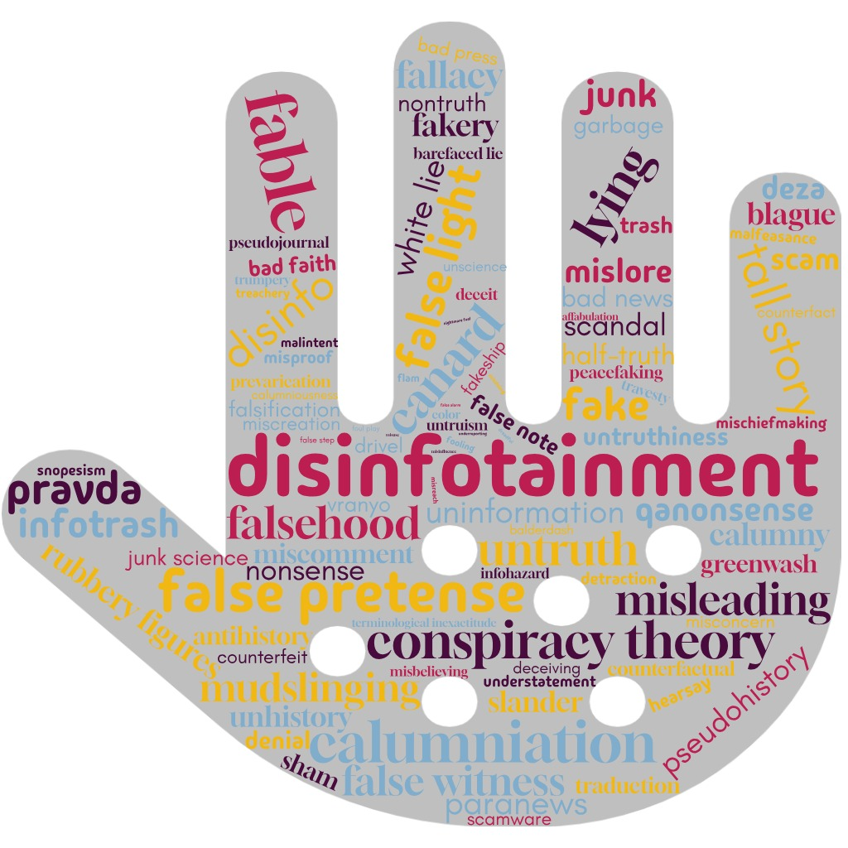
Thank you!

